Slide 1
Applications of DIP
Categorization according to image sources
Electromagnetic (EM) band Imaging
Gamma ray images
x-ray band images
ultra-violet band images
visual light and infra-red images
Imaging based on micro-waves and radio waves
Non-EM band Imaging
Acoustic and ultrasonic images
Electron Microscopy
Computer-generated synthetic images

Slide 2
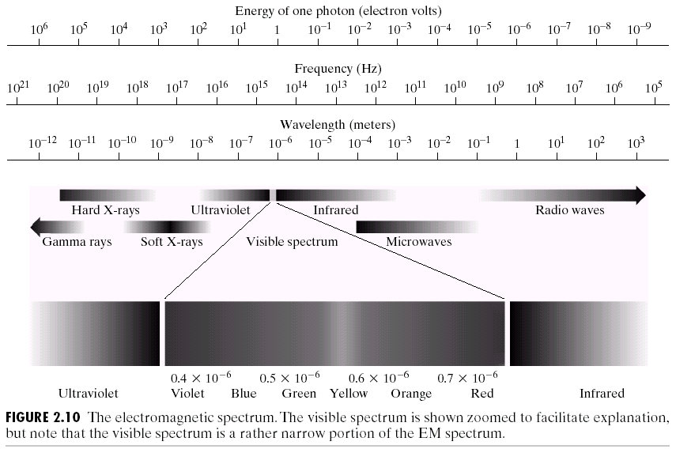
EM Spectrum

Slide 3
Applications of DIP: EM band imaging
Gamma-ray imaging
Nuclear medicine, astronomical observations.
X-ray Imaging
Medical diagnostics (CAT scans, x-ray scans), industry, astronomy.
Ultra-violet imaging
Fluorescence microscopy, astronomy,
Visible & Infrared-band imaging (most widely used)
Light microscopy, astronomy, remote sensing, industry, law enforcement, military reconnaissance, etc.
Micro-wave and radio band imagery
Radar, Medicine (MRI), astronomy

Slide 4
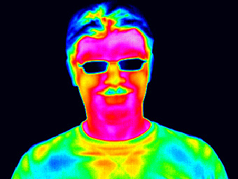
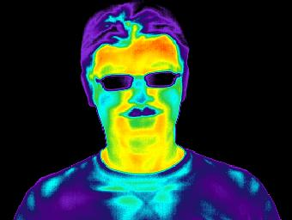
Infrared / Thermal imaging

Slide 5
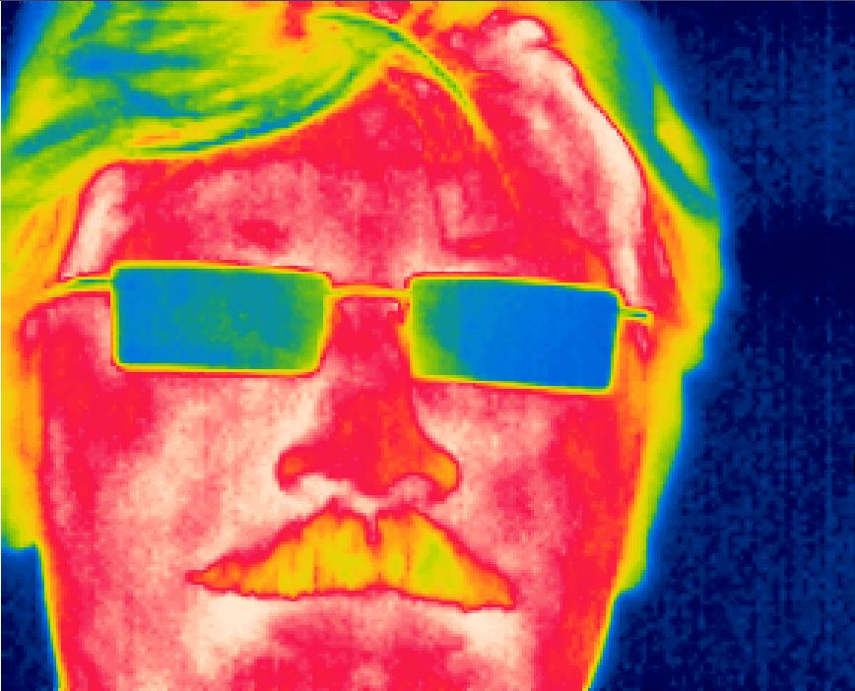
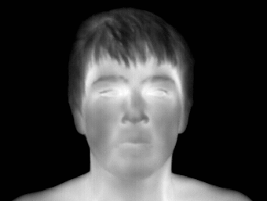
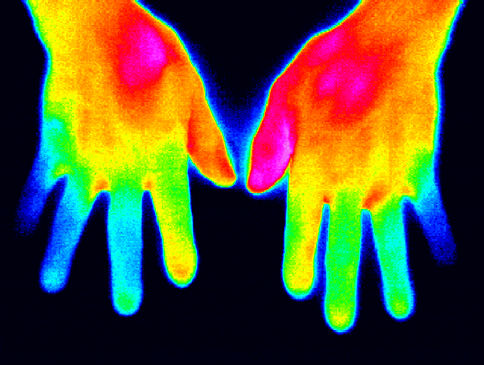
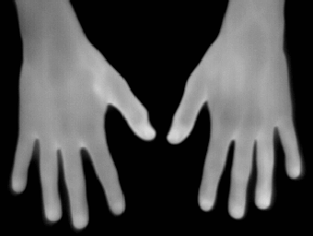
Infrared / Thermal imaging

Slide 6
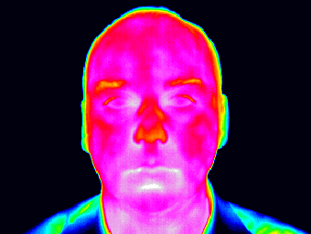

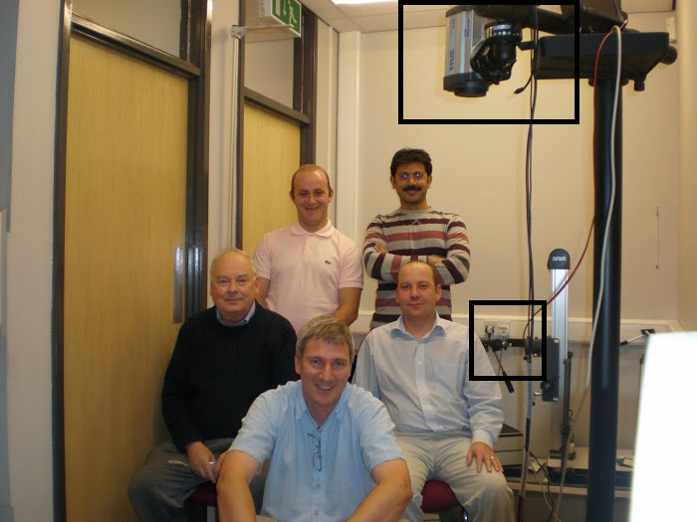
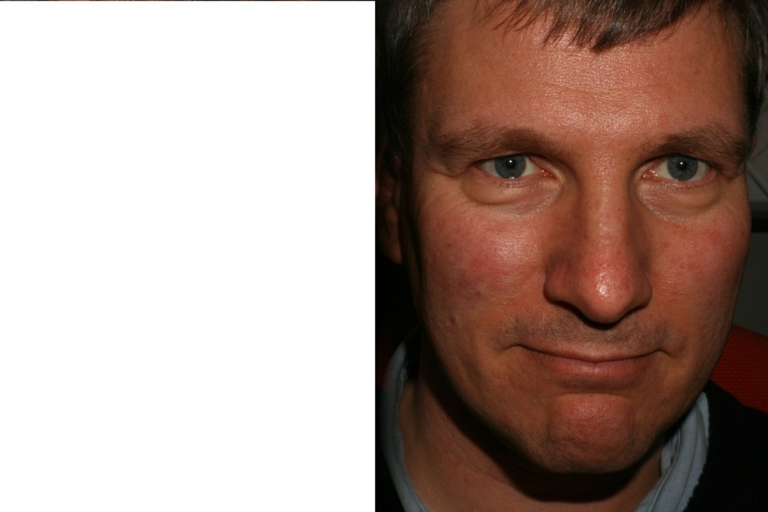
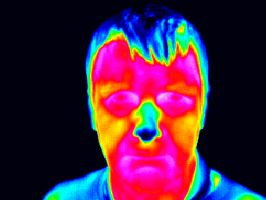
Infrared / Thermal imaging

Slide 7
Applications of DIP: Non-EM band imaging
Acoustic imaging (hundreds of Hz)
Geological exploration (oil exploration)
Ultrasound imaging (millions of Hz)
Industry and medicine
Electron microscopic imaging
Used to achieve magnification of 10,000x or more
(Light microscopy is limited to around 1000x)
Synthetic imaging
3D modeling or visualization systems for flight simulators, machine design, special effects and animations, etc.

Slide 8
Applications of DIP

Slide 9
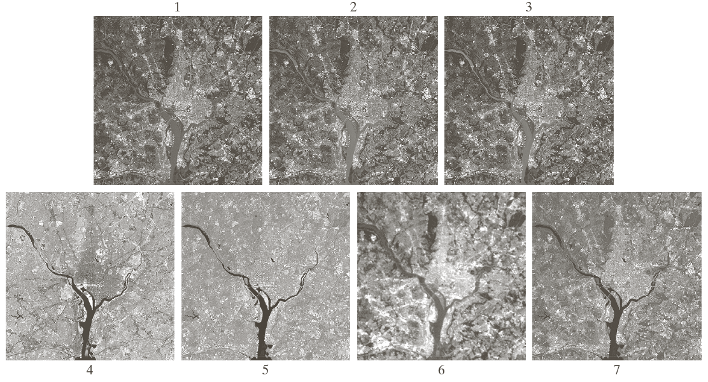
Applications of DIP

Slide 10
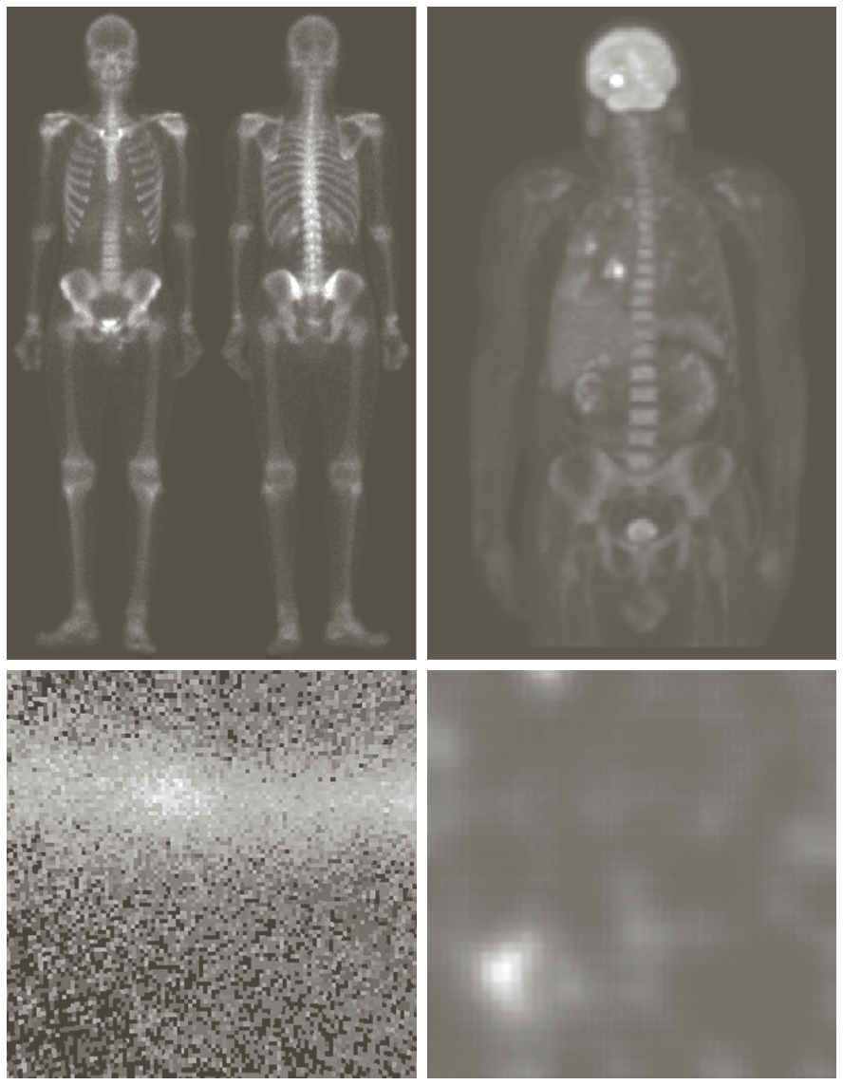
Applications of DIP

Slide 11
Applications of DIP

Slide 12
Applications of DIP

Slide 13
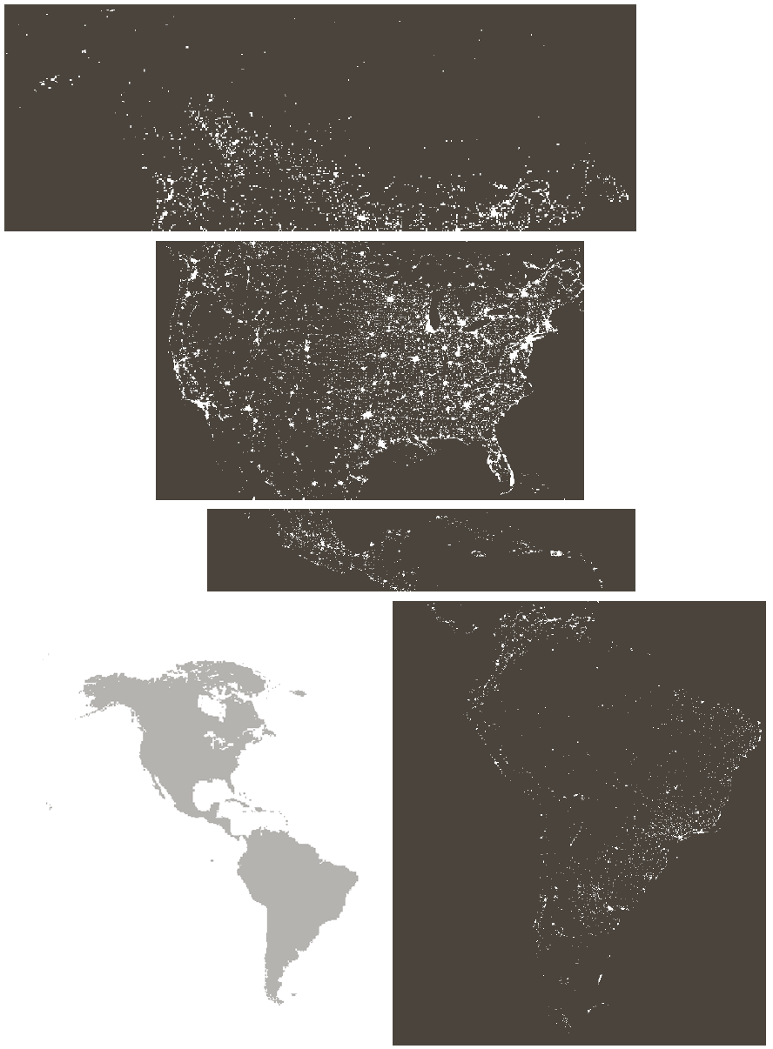
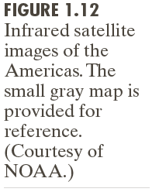
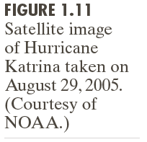
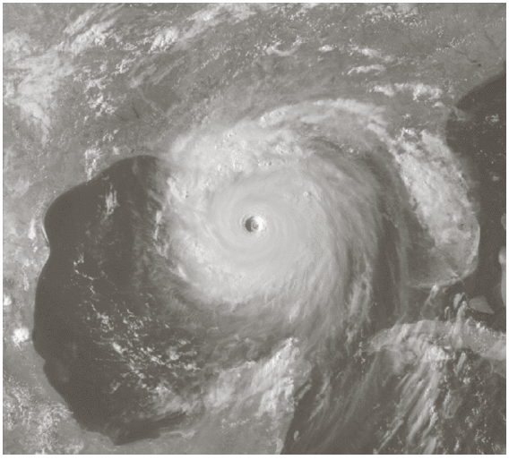
Applications of DIP

Slide 14
Applications of DIP

Slide 15
Applications of DIP

Slide 16
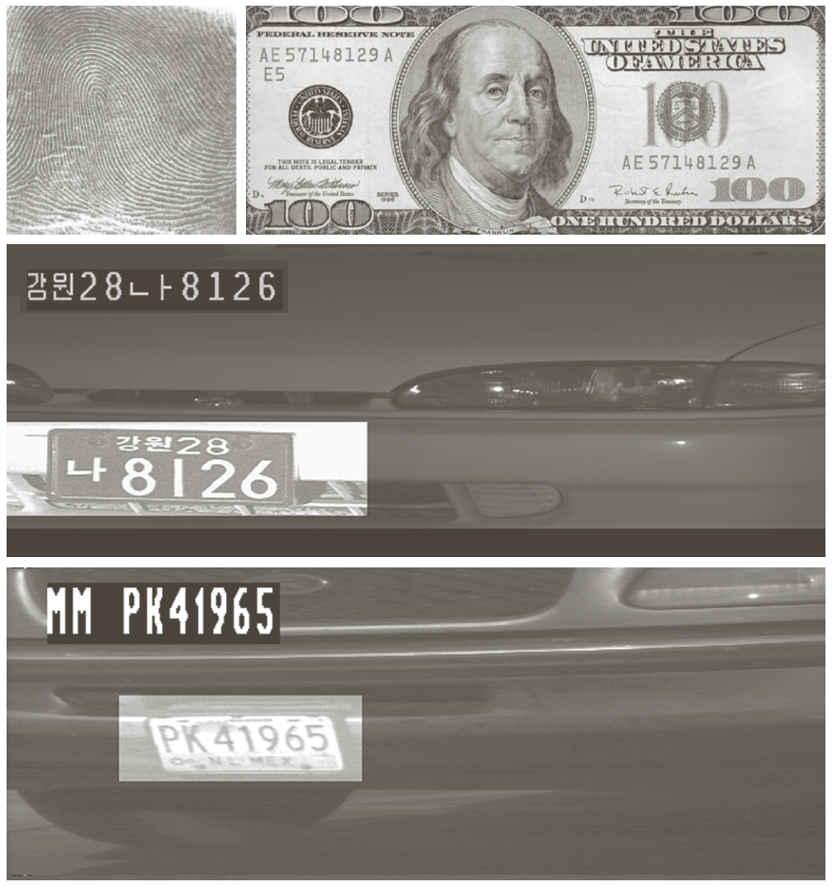
Applications of DIP

Slide 17
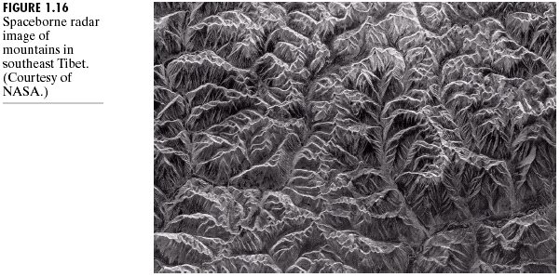
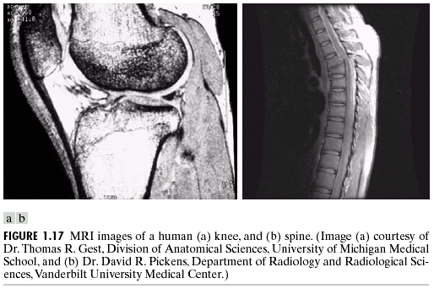
Applications of DIP

Slide 18
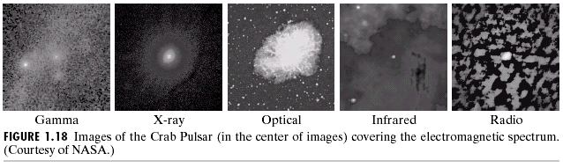
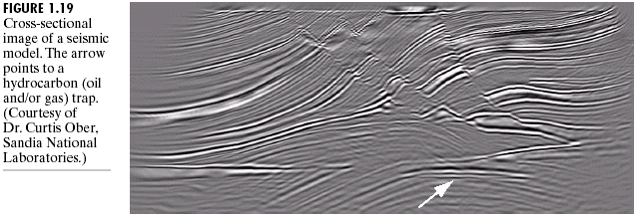
Applications of DIP

Slide 19
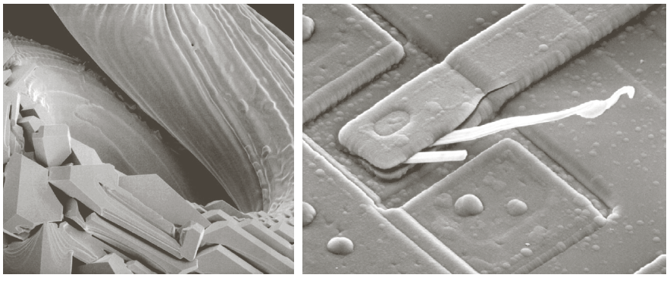
Applications of DIP

Slide 20
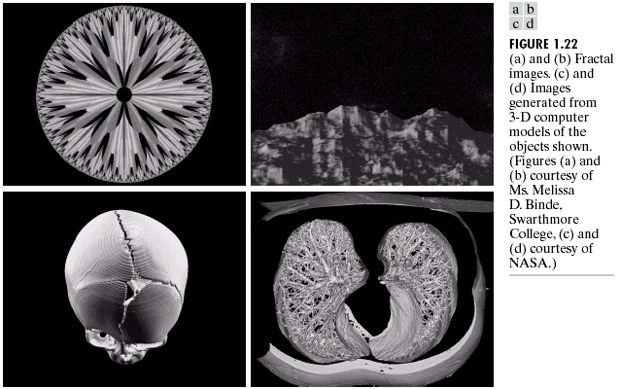
Applications of DIP

Slide 21
Classification of DIP and Computer Vision Processes
Low-level process: (DIP)
Primitive operations where inputs and outputs are images Major functions: image pre-processing like noise reduction, contrast enhancement, image sharpening, etc.
Mid-level process (DIP, Computer Vision and Pattern Recognition)
Inputs are images, outputs are attributes (e.g., edges) major functions: segmentation, description, classification / recognition of objects
High-level process (Computer Vision)
Make sense of an ensemble of recognized objects; perform the cognitive functions normally associated with vision

Slide 22
Image Processing Steps
Physical world
Image acquisition
Imaging
Digitization, quantization and compression
Enhancement and restoration
Image Processing
Image segmentation
Imaging Analysis (Computer Vision and Pattern recognition)
Feature selection/extraction
Image representation
Image understanding (Computer Vision and Pattern recognition)
Image interpretation
Physical action

Slide 23
Image Processing Computer vision and PR
Image acquisition by sensor
Image sampling and quantization
Image Geometrical Rectification
Camera geometry
Feature Extraction
Edge and Interest points detection
Texture and shading
Shape from texture and shading
Calculation on Multiple Views
Multi-view geometry and Stereo imaging
Structure from motion
Segmentation
Impose some order on group of pixels to separate them from each other
Template matching
Image enhancement and restoration
Filtering in spatial domain or frequency domain
Feature Extraction
Edge detection
Interest points
Colored image Processing
Pseudo coloring
Color segmentation
Multi-resolution analysis
Pyramids
Wavelets
Other transformations
Image and video compression
Image compression standards
Video compression standards
Computer Vision
Digital Image Processing
Segmentation
Classification and Recognition
Classification and interpretation of objects based on selected features
Recognize objects using probabilistic techniques
Pattern Recognition

Slide 24
Scope of DIP

